Slide 1




DISCOVER WINE WORLD
WITH US

Slide 2



WINE DISCOVERY TODAY
OUR MISSION
is to develop wine consumption culture among both
beginners and connoisseurs.
Own vehicle fleet
Own import
Extensive distribution network
OUR PHILOSOPHY
We propose wines and spirits from the best producers of all over the world.
We aim to offer an unrivaled selection of products and
services in the market.
Modern warehouse complex
Excellent customer service
Team of professionals
Wine isn't just our business - it's our passion!
Exclusive wine boutiques
chain
Adaptive pricing strategies

Slide 3












725
SKU
MAIN FIGURES
2363
satisfied customers
16
countries presented in portfolio
15
years on the
Russian market
76
producers
295
cities in Russia

Slide 4
COMPANY STRUCTURE
Human Resources Department
2 employees
CEO
Legal Department
3 employees
E-commerce
Department
3 employees
Sales Director
Financial Director
Marketing & Import Director
Logistics Director
Regional Department 14 employees
Account Department 2 employees
Purchasing department 3 employees
Warehouse Operations 16 employees
HoReCa Department 8 employees
Financial department 3 employees
Marketing department 4 employees
International Logistics Department 1 employee
Retail & Boutiques Department
8 employees
IT
3 employees
Certification Department 1 employee
Supermarket Chains Department 6 employees
Domestic Logistics Department
7 employees
Private & Corporate Department 14 employees

Slide 5




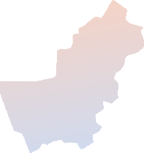

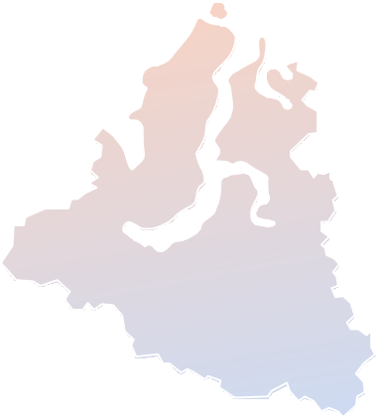


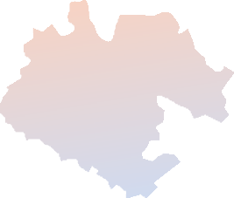




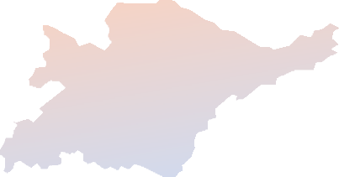









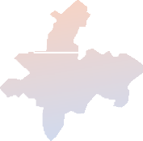


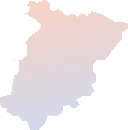



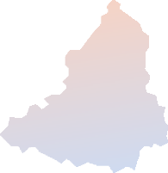

















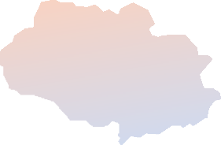


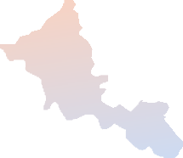
























GEOGRAPHIC REPRESENTATION
12 regional branches
Customers from 65 regions of Russia
295cities all over Russia
Saint-Petersburg
Moscow
5%
Kirov
Nizhniy Novgorod
Perm
Izhevsk
Ekaterinburg
Rostov-on-Don
Saratov
Tyumen
Sales
in bottles
30%
Sochi
Orenburg
Astrakhan
65%
Head Office
Moscow SPB
Regions
Regional branch

Slide 6




TARGET AUDIENCE
Millennials
with medium to high income levels who appreciates good quality wine & spirits
Enthusiasts
eager to explore new dimensions within the wine & spirits industry
Connoisseurs,
frequent visitors of wine & spirits exhibitions and tastings
Wine & spirits market professionals
with discerning preferences

Slide 7
1
COMPETITIVE ADVANTAGES
5
₆
Education program for employees
and customers
Own import
Marketing activities
Individual customer approach
Wine tastings, master classes, exhipitioms
7 Large range of wines and spirits
Full service to ensure reliability, on-time delivery and quality of goods
Promotion attendance at the sales points
8

Slide 8
private & corporate 1 5 %
DISTRIBUTION CHANNELS
customers
2 6 % regions
HoReCa9 %
1 0 % retail & boutiques
4 0 %
federal & local supermarket
chains

Slide 9




























KEY PARTNERS
Federal & local supermarket chains
Private & corporate customers
Retail & boutiques
HoReCa
Total amount of customers: 41
Total amount of customers: 375
Total amount of customers: 350
Total amount of customers: 1561

Slide 10



ASSORTMENT PORTFOLIO
20%
27%
AAssssoorrttmmeenntt
Sales
in bottles
7%
62%
18%
66%
still wine
champagne and sparkling wine spirits

Slide 11
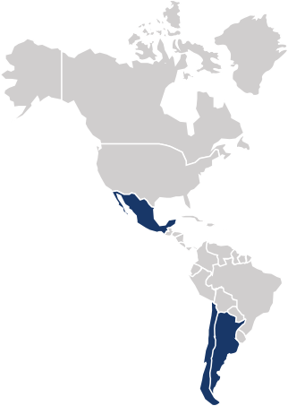
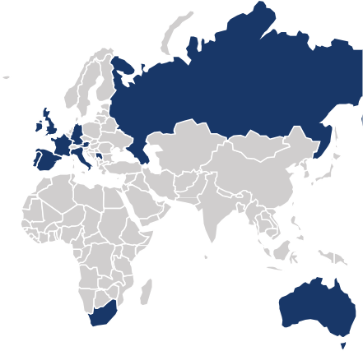
PRODUCERS GEOGRAPHY
ITALY
Trentino – Alto-Adige
ITALY
Abruzzo
Gran Sasso
Campania
FRANCE
Bordeaux
Gericot
Producta Vignobles
Cordier SAS
SARL Bouju
GFA Des Vignobles Gillet
Rhone Valley
Vignerons Proprietes Associes
Provence
Le Petits fils de Veuve Ambal
Les Grands Chais de France
South-West
Producta Vignobles
Vinovalie
Armagnac
H. Dartigalongue & Fils
Languedoc-Roussillon
GERMANY
Nahe
Weingut Prinz Salm
Pfalz
Schwedhelm
Cantine di Ora
Distilleria Pilzer
Hans Rottensteiner
Lombardy
•
Terre del Vulcano
Puglia
Azienda Agricola Monte Cicogna
Azienda Agricola Villa
Societa Agricola Mazzolino
Cantina Diomede
Luccarelli
Sicily
AUSTRIA
Wachau
Firma Familie Schmelz
Kremstal
Weingut Stift Göttweig
SERBIA
Fruska Gora
Vinarija Kovaсeviс Irig
GEORGIA
Kahety
Kompaniya gruzinskoj lozy i vina
Friuli – Venezia Giulia
Azienda Agricola Lorenzon
Rodaro Paolo
Veneto
•
•
•
Azienda Agricola F. Tornatore Cantina Cellaro
Schenk Italia
Sardinia
ARGENTINA
Mendoza
La Rural Vinedos y Bodegas
Cantine di Ora
Giacomo Sperone
Schenk Italia
Atzei Vini
Marco Zanatta
Piedmont
FRANCE
Champagne
MEXICO
Tequila Magdalena
Compañía Tequilera de Arandas S.A. de C.V
SOUTH AFRICA
Elgin Valley
Thelema Mountain Vineyards
Western Cape
Origin Wine Stellenbosch
Kleine Zalze Wines
Antoniolo
Cantine Ascheri Giacomo
Tenute Neirano
Les Grands Chais de France
Les Vignerons du Sieur D'Arques
Champagne AR Lenoble
Champagne Prestige des Sacres
Alsace
Fleischer
Calvados
Jean-François Guillouet-Huard
Loire Valley
Tuscany
SPAIN
Rias Baixas
Cooperativa Vitivinícola Arousana
Navarra
Sociedad Cooperativa Nequeas
Penedes
Bardinet Wines
Priorat, Terra Alta
Azienda Agricola Canneto
Azienda Agricola Giorgio Meletti Cavallari
La Gerla
Pianirossi
Schenk Italia
Terre Natuzzi
Tenute Rossetti
GREAT BRITAIN
Thames Distillers Limited
Confrérie des Vignerons de Oisly & Thésée
Fournier Pere & Fils
Lacheteau
Loire Propiretes
SCOTLAND
AUSTRALIA
South Australia
Kilikanoon Wines
Beveland
Bardinet Wines
Burgundy
Domaine Nathalie & Gilles Fevre
Maison Jean Bouchard
Cognac
Domini de la Cartoixa
Rioja
Bodegas y Vinedos de Gomez Cruzado
RUSSIA
Kuban
Berdyaev Winery
Chateau Pinot
Ribera del Duero
Viña Buena S.A.
Andalusia
Sanchez Romate
CHILE
Central Valley, Aconcagua
Vina del Pedregal
Daniel Bouju
Distillerie des Moisans
Jarnac
Distillerie Tessendier & Fils
PORTUGAL
Douro
Quinta do Infantado

Slide 12


















BRAND PORTFOLIO

Slide 13


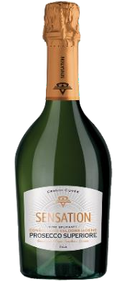




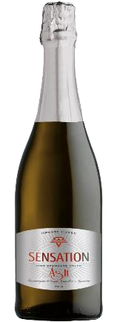
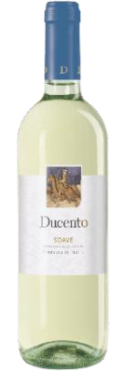
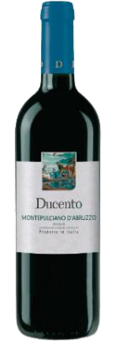

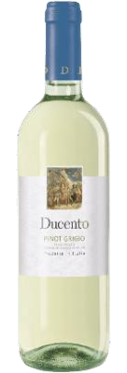
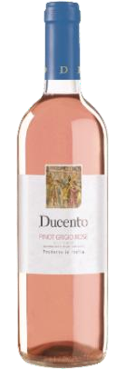
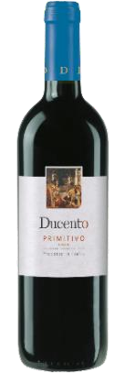



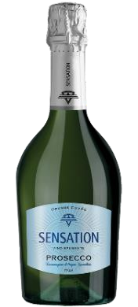
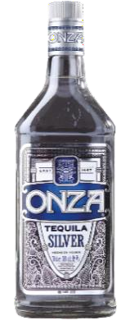







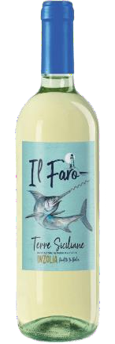
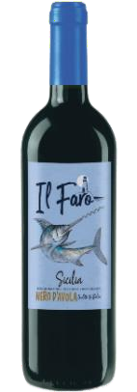
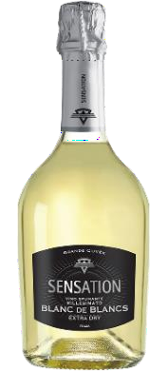
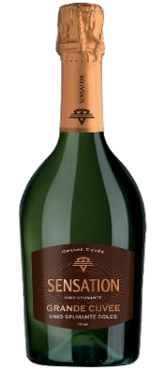
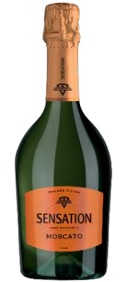

OWN BRANDS
Premium level
Value for
money
Entry level

Slide 14







MARKETING TOOLS
Motivation programs for partners
Wine lists development
Discounts and special
price tags for customers
Branded cars
B2B
POSM:
advertising stands, shelf talkers, corkscrews, bags and etc
Additional sales locations in supermarkets
Our team of merchandisers and consultants
Exhibitions and private tastings

Slide 15
MARKETING TOOLS
Consulting from competent
experts
Wine casino
Master classes in customers’ office
Wide range of corporate gifts
B2C
Competent help in selecting wines & spirits
Private
tastings & wine
interactives
Exclusive wine list for any kind of event
Discount & loyalty programs

Slide 16

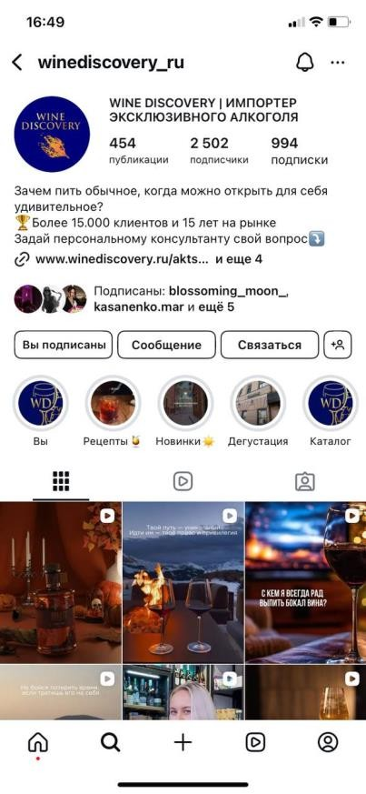
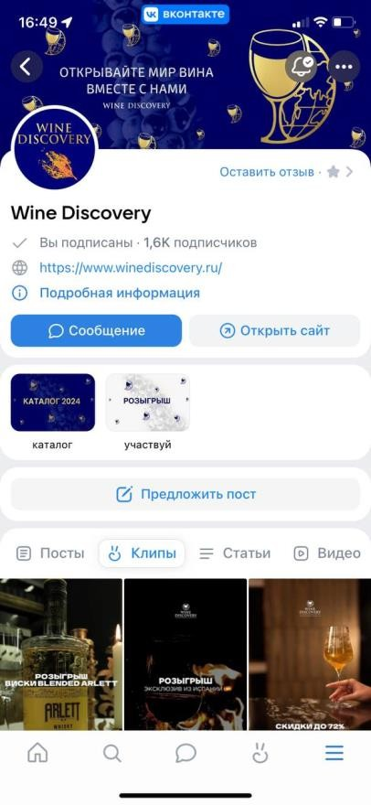
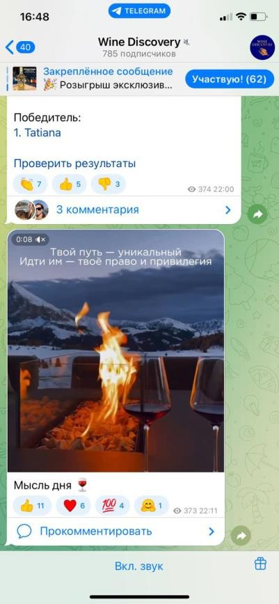
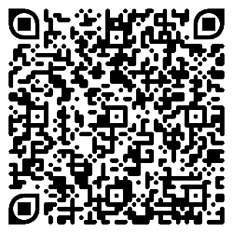
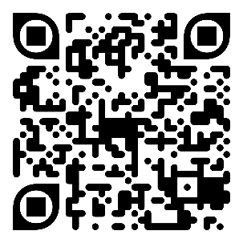
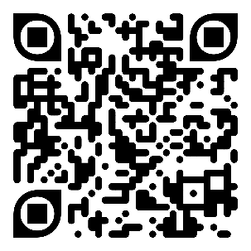
SMM
VK: wine_discovery
Instagram: winediscovery_ru
Telegram: wine_discovery

Slide 17
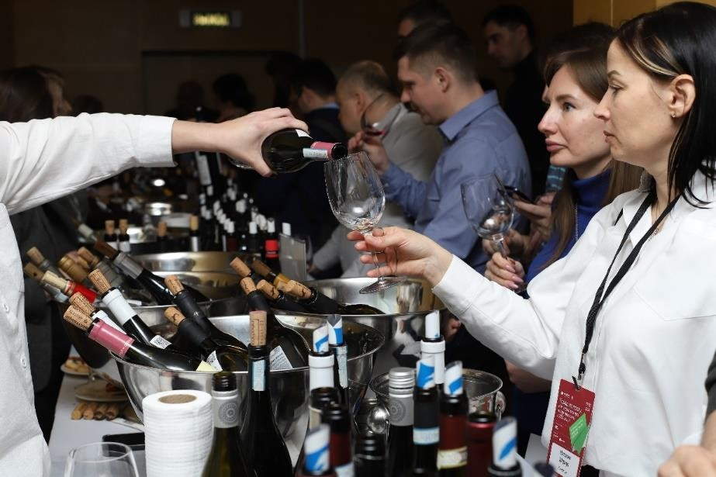
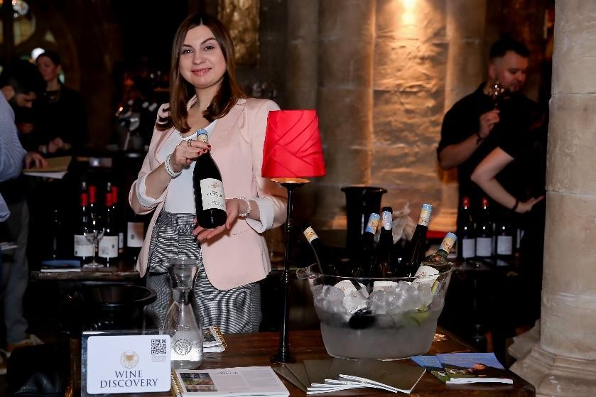

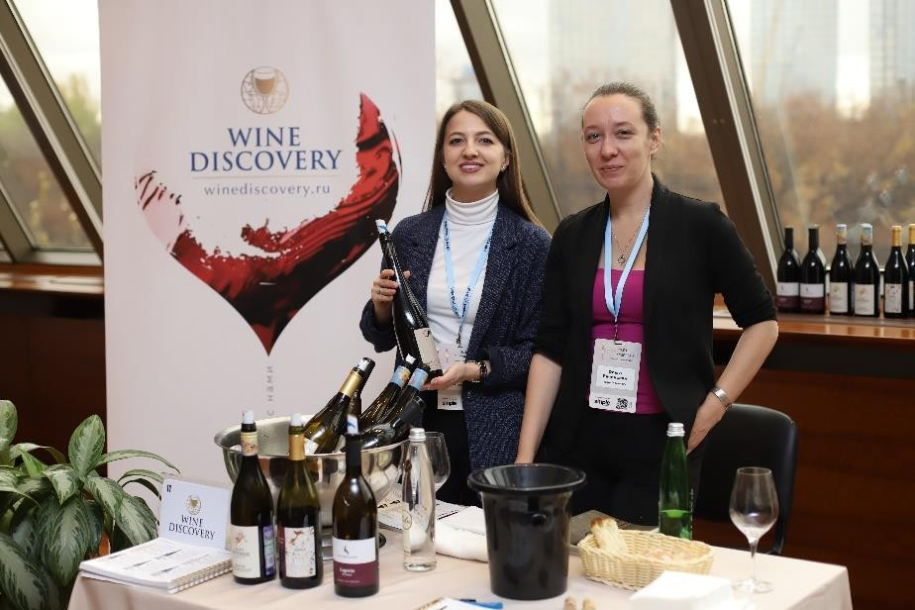
EXHIBITIONS AND WINE TASTINGS
Prodexpo
Between heaven
and earth
Bigatifest
Wines with umlaut

Slide 18

CONTACT US
Head office in Moscow:
29 Burakova st., Moscow, Russia
+7 (495) 727-01-98
info@winediscovery.ru winediscovery.ru
Office in Saint Petersburg:
7 Roentgen str., office 67, 68 St. Petersburg, Russia
Our boutiques Wine Discovery:
25/2 Shabolovka str., Moscow, Russia 61/1 Leninsky ave., Moscow, Russia
5/1 Ochakovskoe highway, Moscow, Russia
11 Viktorenko str., Moscow, Russia
82A Central str., Istra, Moscow region, Russia
29/1 Oktyabrskaya Fabrika settlement, Istra, Moscow region, Russia 7 Kuibyshev str., Saint-Petersburg, Russia
12 Kolokolnaya str., Saint-Petersburg, Russia

